Slide 1
Emotional Intelligence
Martha Karunakar​

Slide 2
What is EI?
Emotional Quotient/Intelligence (EQ or EI) is a term created by two researchers – Peter Salavoy and John Mayer – and popularized by Dan Goleman in his 1996 book of the same name.
EI is the capacity to be aware of, control, and express one's emotions, and to handle interpersonal relationships judiciously and empathetically.

Slide 3
What is EI?
EI is the ability to recognize your emotions, understand them, and see how they affect those around you
It also means you understand other people’s emotions
This allows you to manage your relationships better, and avoid potential conflicts
It can impact communication, team work and over all job performance

Slide 4
Types of Emotions
Basic emotions: These are the most fundamental emotions and are believed to be universal across cultures. Examples include happiness, sadness, anger, fear, surprise, and disgust.
Complex emotions: These are emotions that are more nuanced and may involve a combination of basic emotions. Examples include jealousy, gratitude, love, and shame.
Positive emotions: These are emotions that are generally pleasant and desirable, such as happiness, joy, and contentment.

Slide 5
Types of Emotions
3. Negative emotions: These are emotions that are generally unpleasant and undesirable, such as anger, sadness, and anxiety.
4. Social emotions: These are emotions that are specifically related to social interactions and relationships. Examples include empathy, compassion, guilt, and shame.
5. Self-conscious emotions: These are emotions that involve the evaluation of oneself in relation to social norms and standards, such as guilt, shame, and pride.

Slide 6
Types of Emotions
7. Aesthetic emotions: These are emotions that are related to the appreciation of beauty or art, such as awe, wonder, and admiration.
8. Physiological emotions: These are emotions that are related to bodily sensations and physiological responses, such as hunger, thirst, and sexual arousal.

Slide 7
Self Conscious Emotions
They are a specific type of emotion that involve the evaluation of oneself in relation to social norms and standards.
These emotions are complex and typically involve a combination of cognitive and affective processes.
Examples of self-conscious emotions include guilt, shame, embarrassment, pride, and envy.
Guilt is an emotion that arises when an individual feels responsible for a wrongdoing or mistake. This emotion often leads to a desire to make amends or correct the mistake.

Slide 8
Self Conscious Emotions
Shame is an emotion that arises when an individual perceives that they have failed to meet a social norm or standard. This emotion can lead to feelings of worthlessness or a desire to hide or withdraw from others.
Embarrassment is an emotion that arises when an individual feels that they have violated a social norm or made a social faux pas. This emotion can lead to a desire to apologize or make amends, or to withdraw from social situations.
Pride is an emotion that arises when an individual perceives that they have met a social norm or standard, or achieved something that is valued by their social group. This emotion can lead to a sense of accomplishment and a desire to share one's success with others.
Envy is an emotion that arises when an individual perceives that others have something that they lack, and that this thing is important or desirable. This emotion can lead to feelings of resentment or a desire to obtain what others have.

Slide 9
How can one detect emotions, feelings and behaviour?
Detecting emotions, feelings, and behavior in others requires a combination of observation, interpretation, and empathy.
Observe body language: Body language can provide important clues about how someone is feeling. Pay attention to things like facial expressions, posture, and gestures to get a sense of the person's emotional state.
Listen carefully: People often express their emotions through the tone of their voice and the words they use. Pay attention to the person's tone, pitch, and speed of speech to get a sense of their emotional state.

Slide 10
How can one detect emotions, feelings and behaviour?
3. Ask questions: Sometimes the best way to understand someone's emotions and feelings is to simply ask them. Ask open-ended questions that encourage the person to express themselves and share their thoughts and feelings.
4. Be empathetic: Empathy is the ability to understand and share someone else's feelings. Put yourself in the other person's shoes and try to imagine how they might be feeling in a particular situation.

Slide 11
How can one detect emotions, feelings and behaviour?
5. Consider the context: The context of a situation can provide important clues about how someone is feeling or why they might be behaving in a certain way. Consider the social and environmental factors that might be influencing the person's emotional state or behavior.
6. Be mindful of your own biases: Our own biases and assumptions can influence how we interpret someone else's emotions and behavior. Try to be aware of your own biases and approach the situation with an open mind.
By combining these strategies and being mindful of the complexities of emotions, feelings, and behavior, you can become more adept at detecting and interpreting the emotional states of others.

Slide 12
Characteristics of people with high degree of EI :
LISTEN to others and their team and communicate well
Stay cool under pressure
Know when to trust their intuition
Never let their emotions get the best of them
Adapt to rapidly changing work environments,
Work well in teams and self-manage

Slide 13
Five measures/elements/components of EI
According to Daniel Goleman , an American psychologist who helped to popularize emotional intelligence, there are five key elements to it:
1. Self-awareness
2. Self-regulation
3. Intrinsic Motivation
4. Empathy
5. Social skills

Slide 14
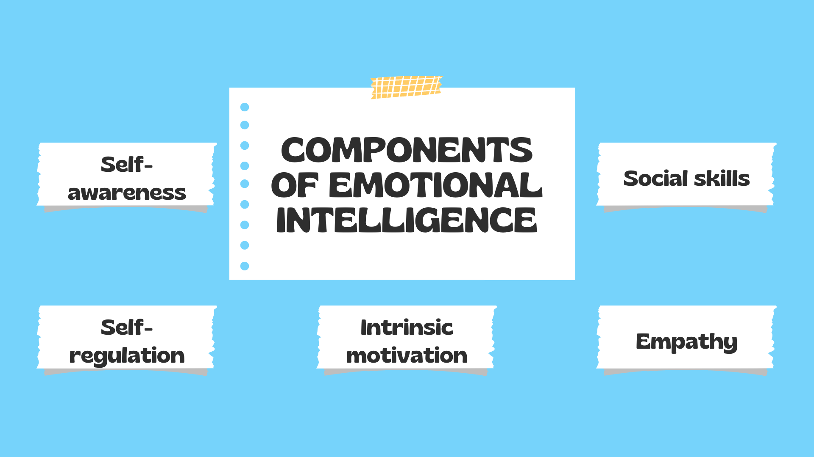

Slide 15
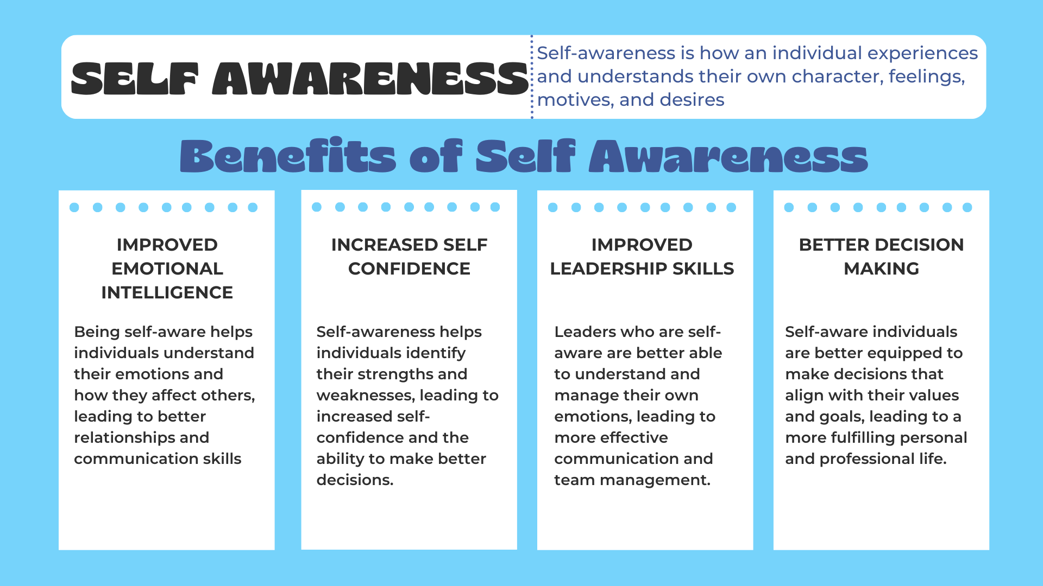

Slide 16
SELF-AWARENESS
Being self-aware when you're in a leadership position also means having a clear picture of your strengths and weaknesses, and it means behaving with humility
So, what can you do to improve your self-awareness?
Keep a journal – Journals help you improve your self-awareness. If you spend just a few minutes each day writing down your thoughts, this can move you to a higher degree of self-awareness.
Slow down – When you experience anger or other strong emotions, slow down to examine why. Remember, no matter what the situation, you can always choose how you react to it

Slide 17
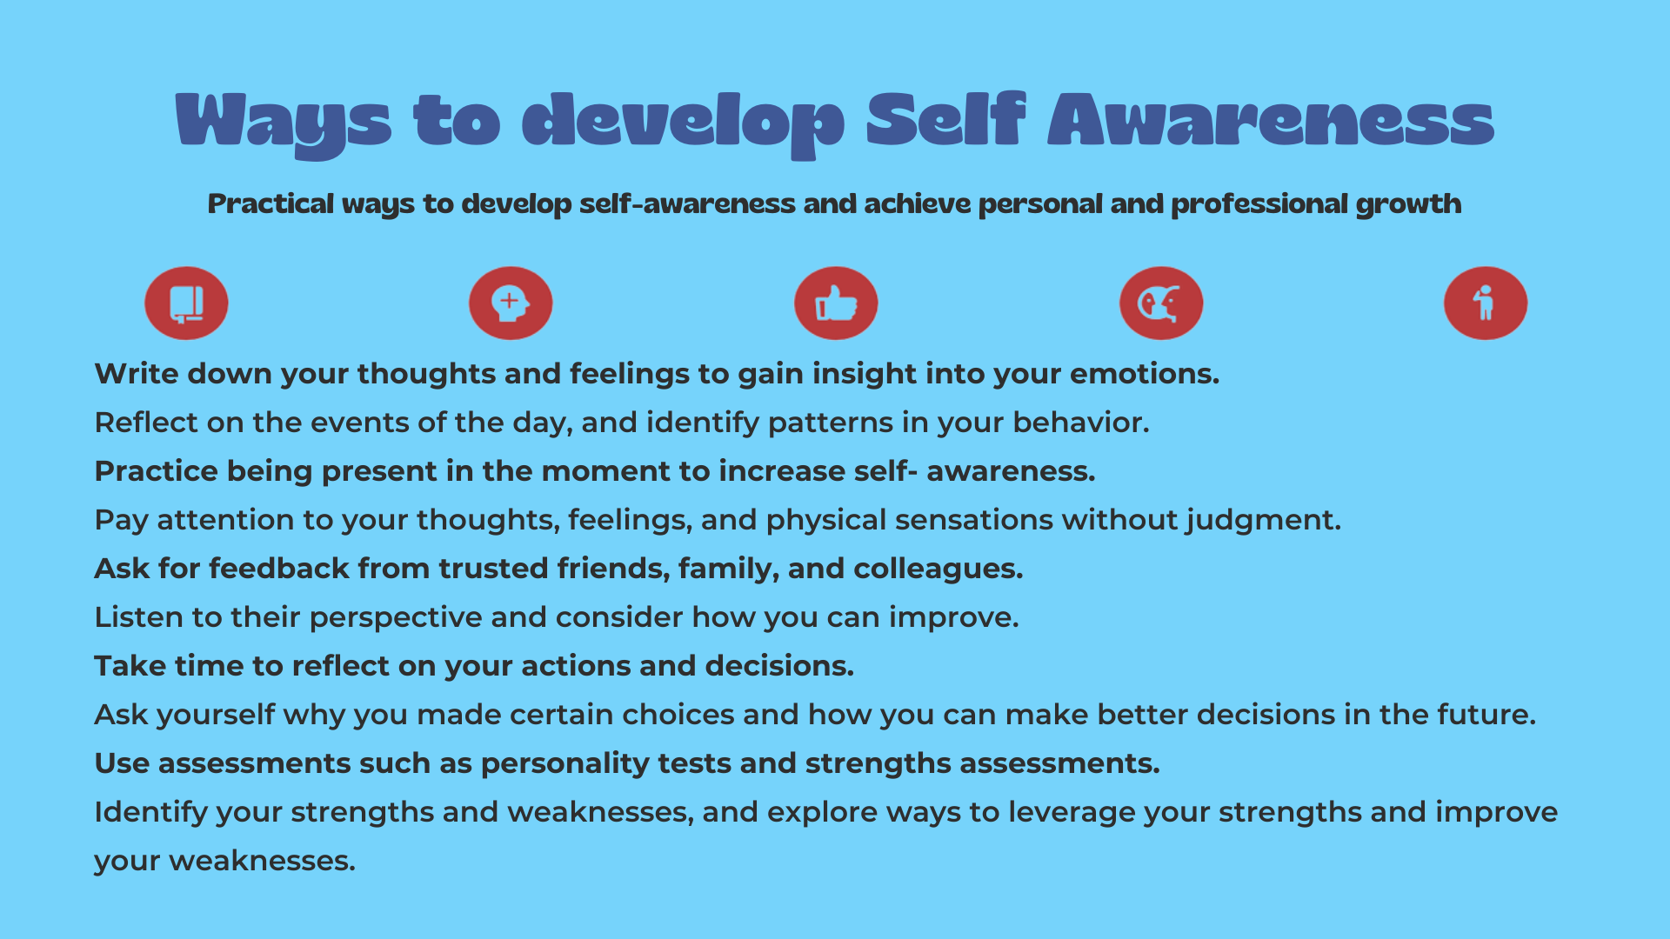

Slide 18
SELF REGULATION/Emotion Regulation
Self or Emotion regulation, also known as self management is learned in childhood, as the ability to reason develops and as children begin to realise that emotions can be controlled.
Self-regulation is the ability to control one's behavior, emotions, and thoughts in the pursuit of long-term goals. Emotional self-regulation refers to the ability to manage disruptive emotions and impulses—in other words, to think before acting.
If emotion regulation is low, then the child (and later the adult) is likely to be uncontrolled, unconstructive (socially), aggressive and susceptible to circumstances such as social rejection.
If the level of emotion regulation is high, then general socio-emotional competence is increased.

Slide 19
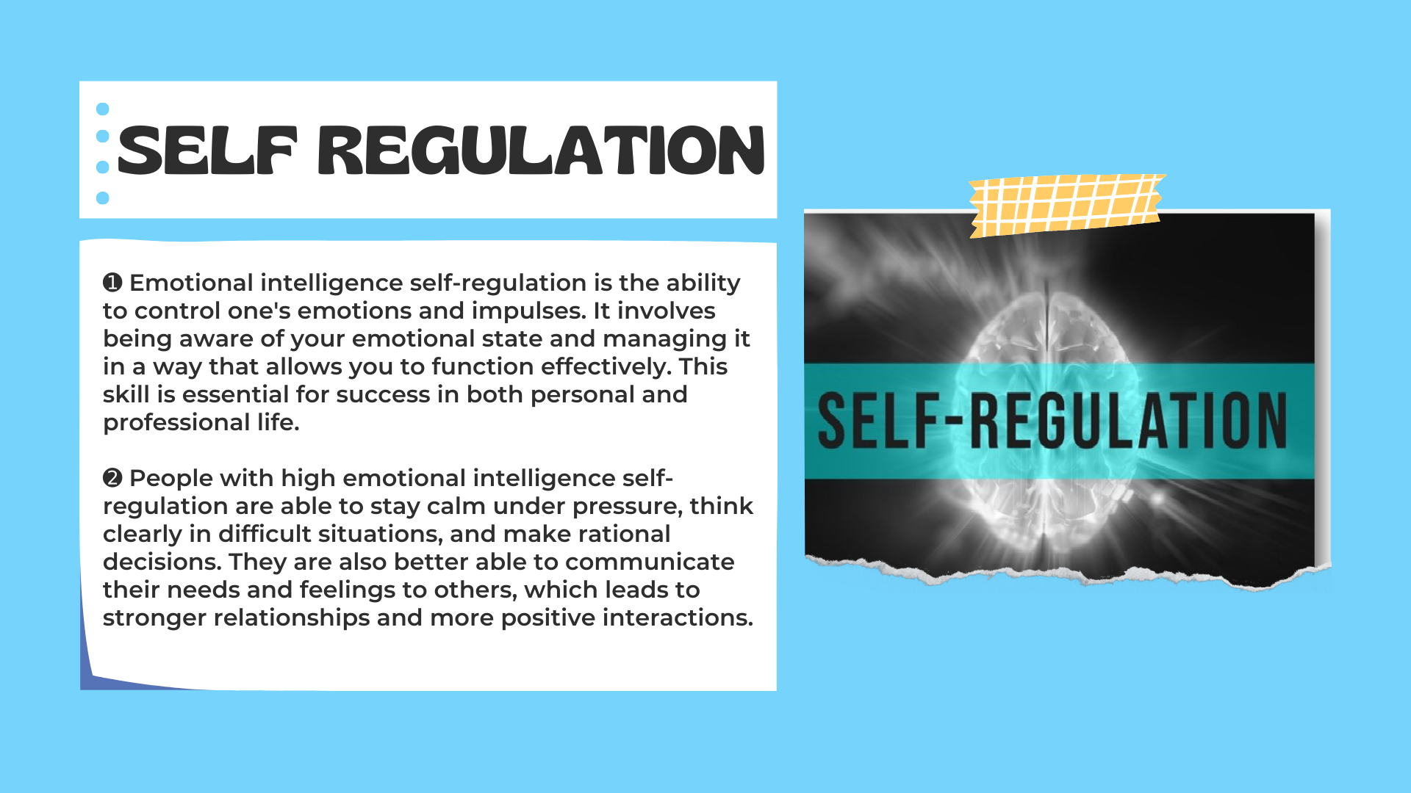

Slide 20
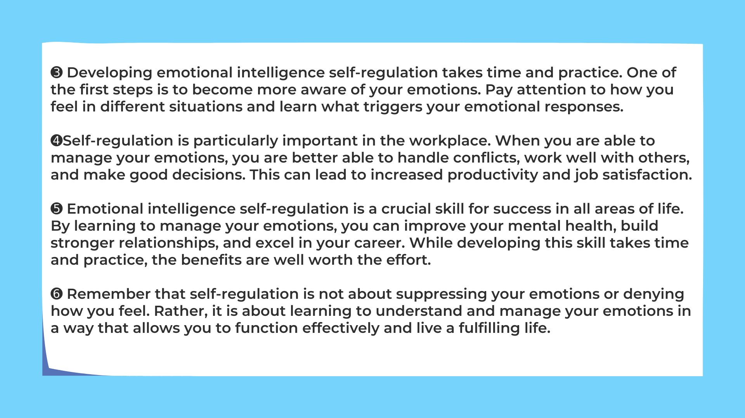

Slide 21
Real-life examples
1. Jacinda Ardern (New Zealand) – Responding to the Christchurch Mosque Attacks (2019)
Situation: The country was grieving and fearful. There was immense political and media pressure.
How she regulated her emotions: Acknowledged her own sadness without allowing anger to dictate her actions.
Comforted victims' families instead of blaming communities. Introduced gun law reforms calmly and quickly.
2. Captain Chesley "Sully" Sullenberger (USA) – Emergency Landing on the Hudson River (2009)
Situation: 155 lives were in danger. Only minutes remained before impact.
Self-regulation: Controlled panic. Spoke calmly to air traffic control. Focused on the next decision instead of the fear.
Self-regulation is not about eliminating emotions such as anger, fear, or sadness. It is about recognizing those emotions, pausing before reacting, and choosing a response that aligns with one's values and long-term goals.

Slide 22
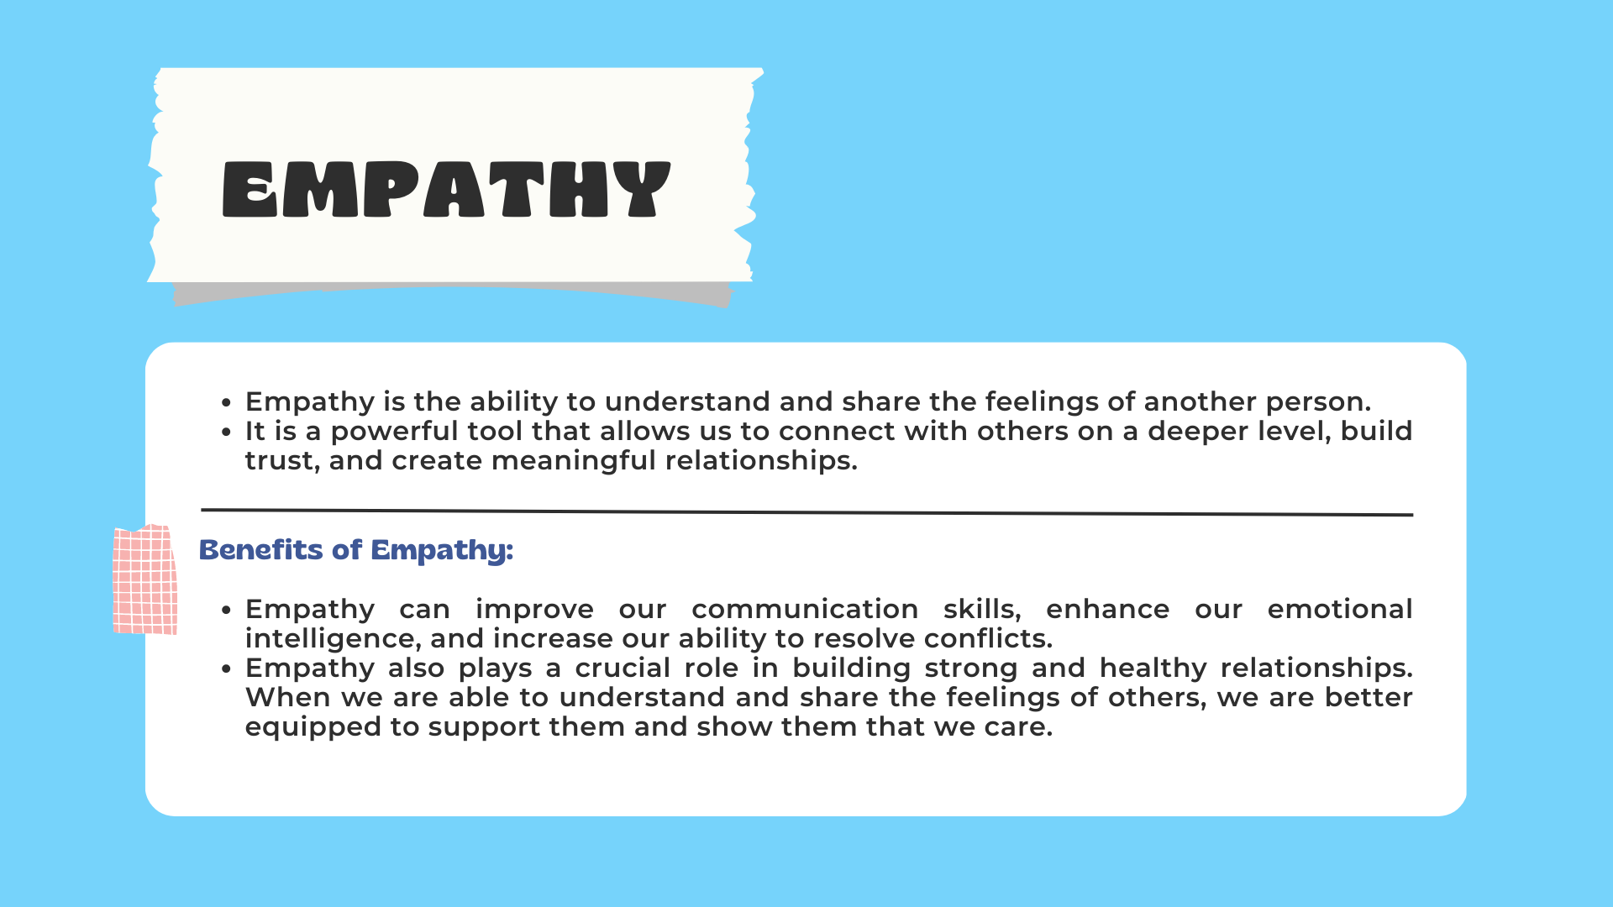

Slide 23
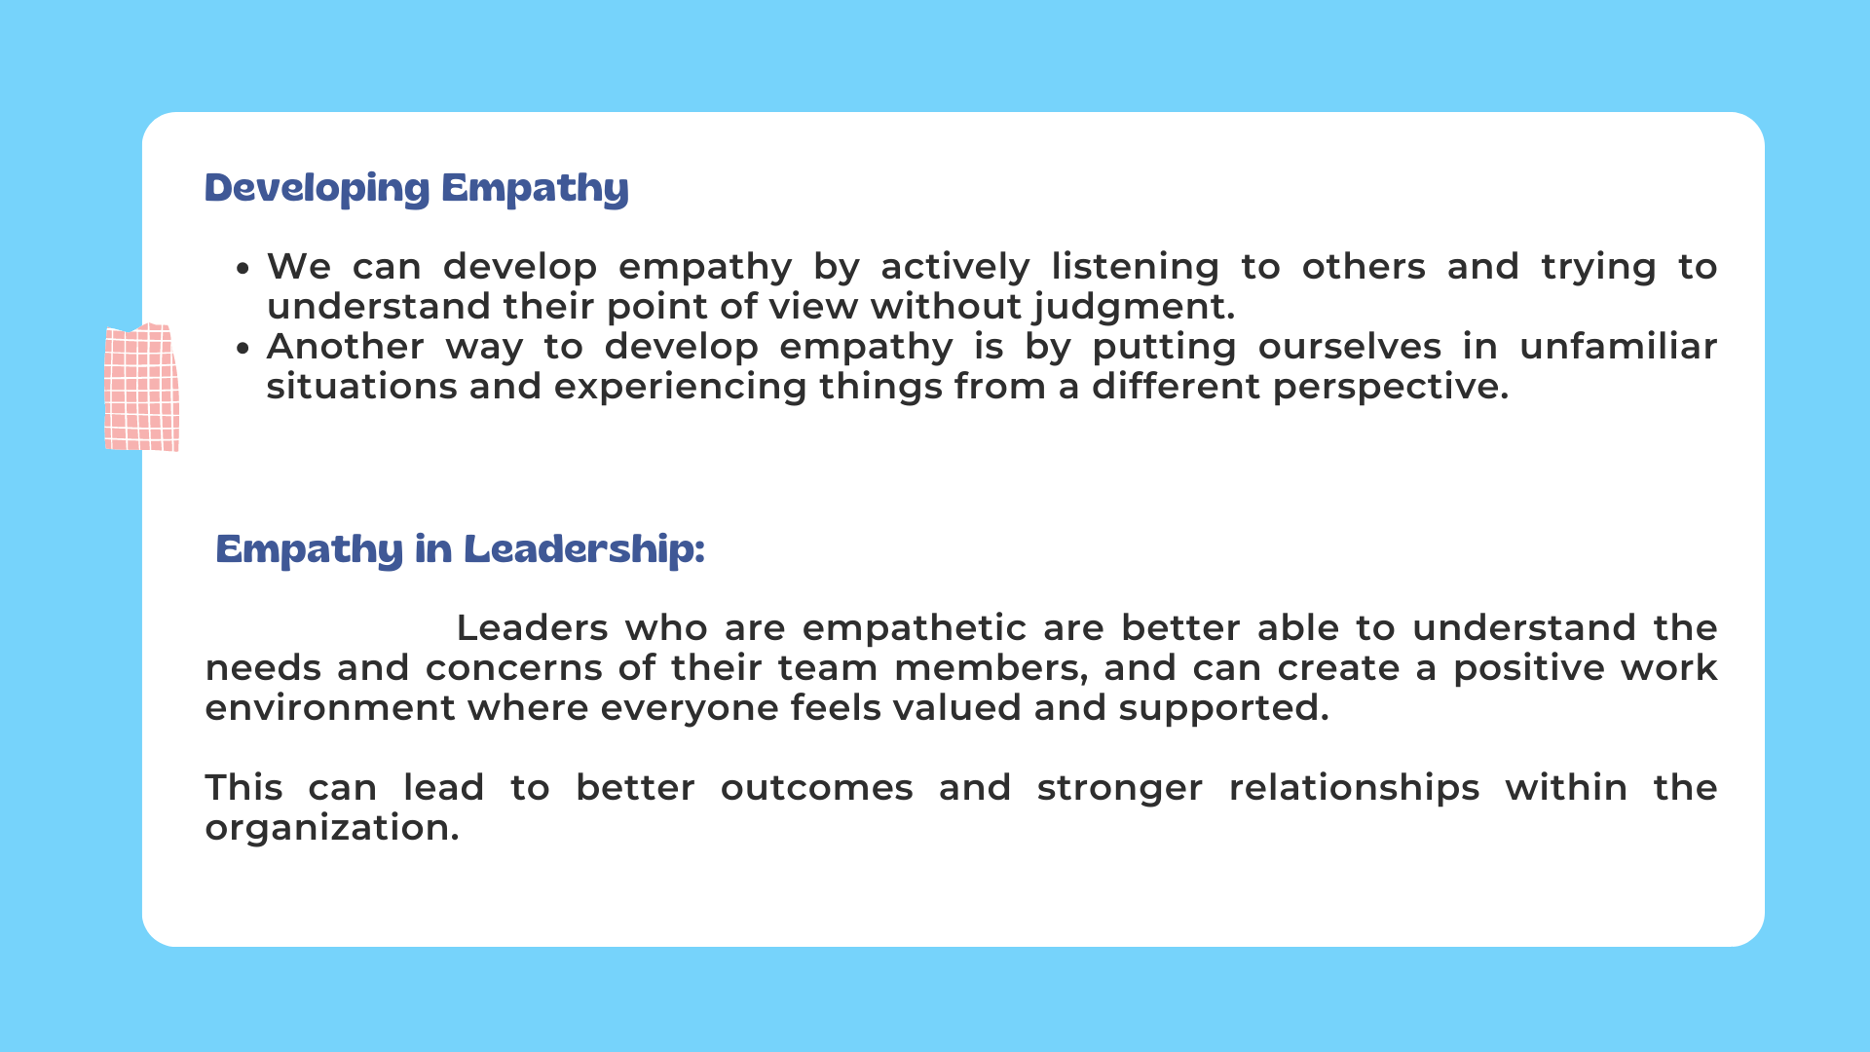

Slide 24
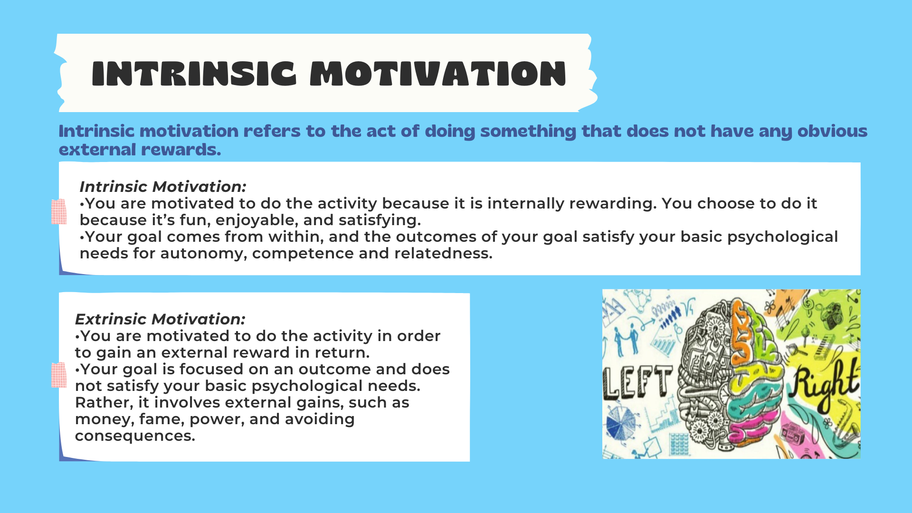

Slide 25
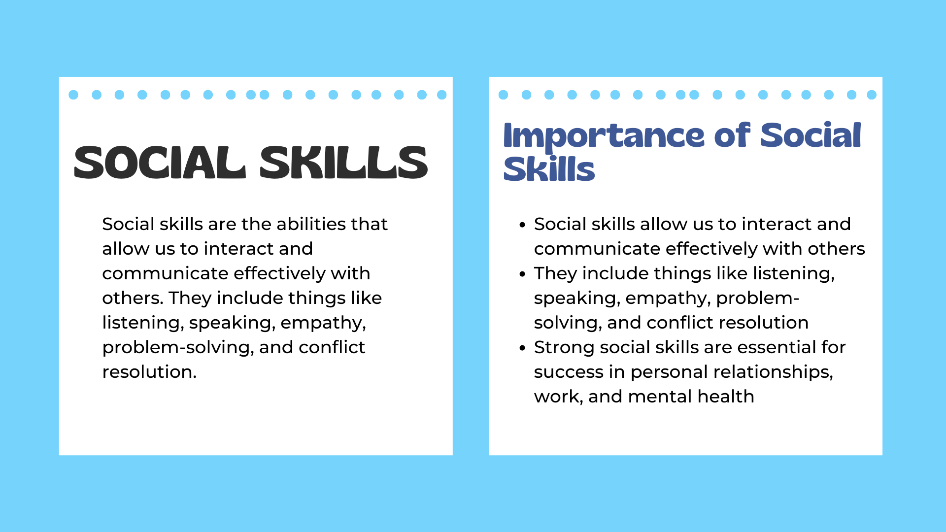

Slide 26
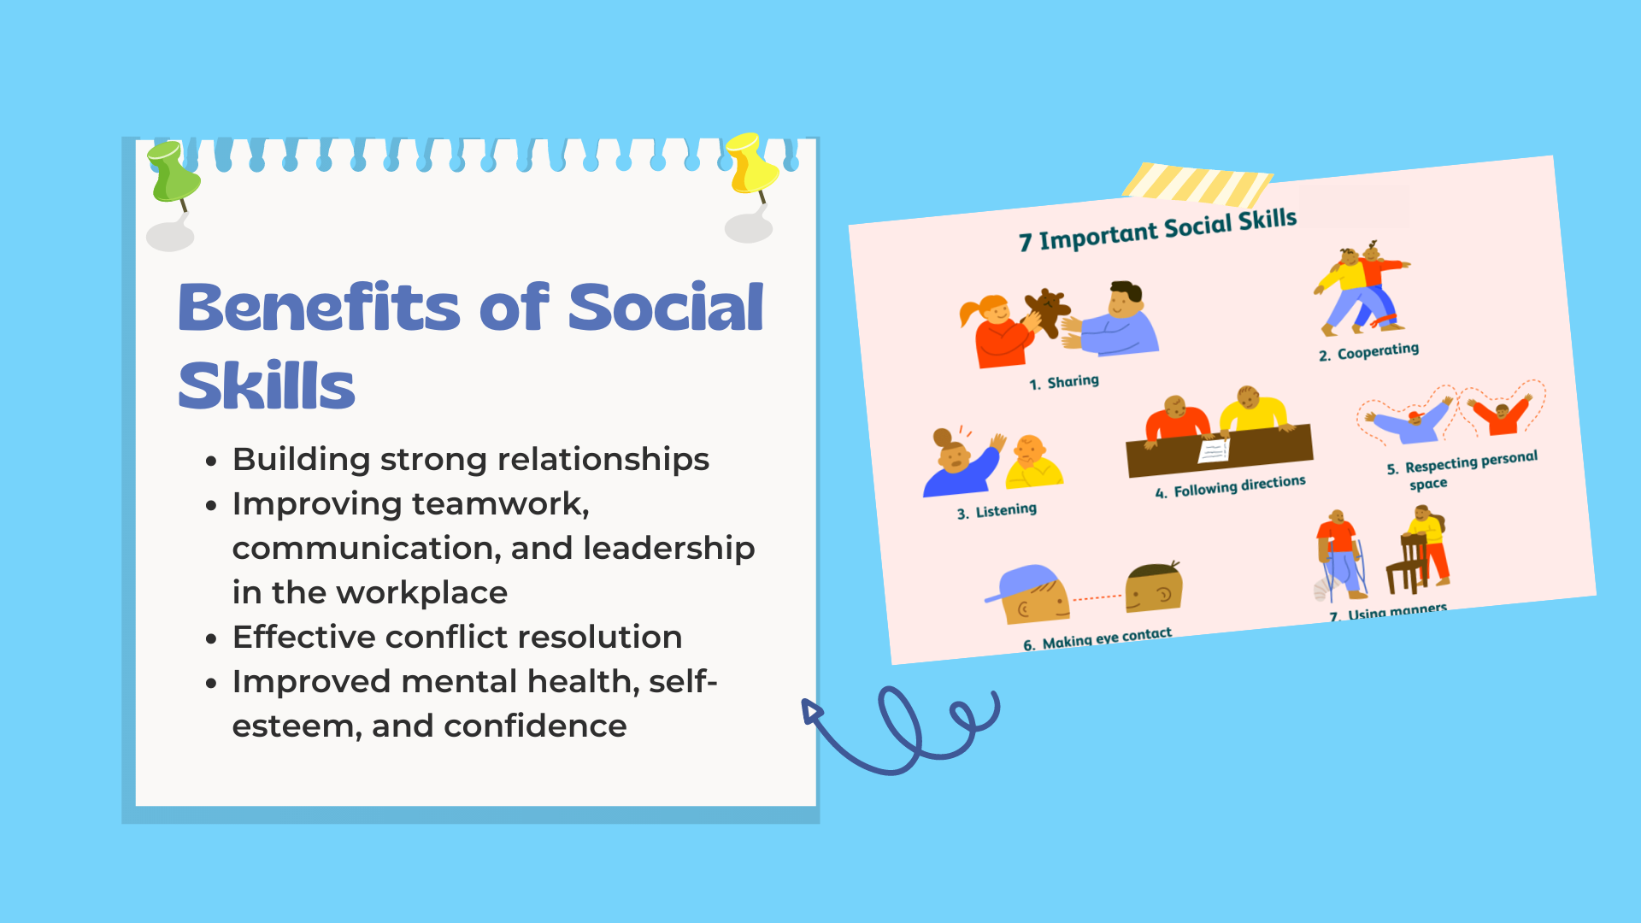

Slide 27
How to improve EI
Be more self-aware
Recognize how others feel
Practice active listening
Communicate clearly
Stay positive
Empathize
Be open-minded
Listen to feedback
Stay calm under pressure

Slide 28
Thank you

